Slide 1

















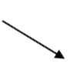
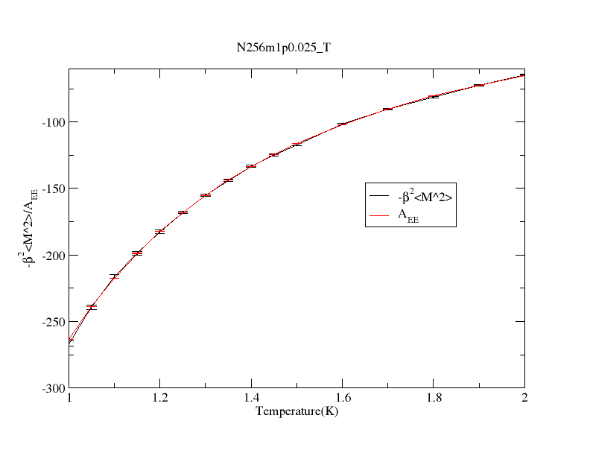
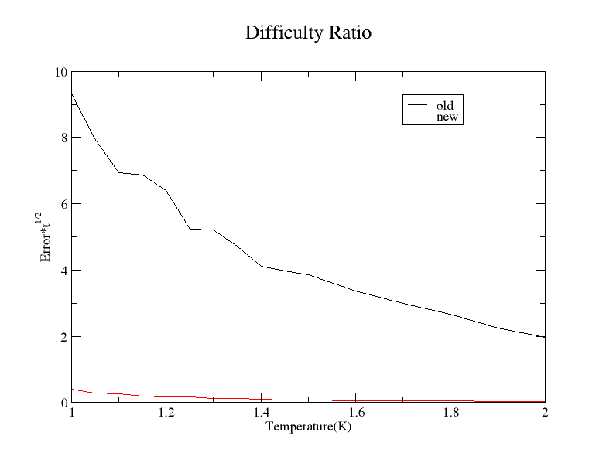


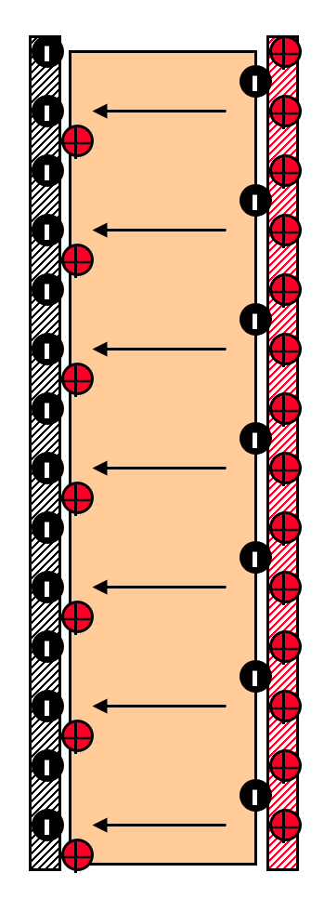
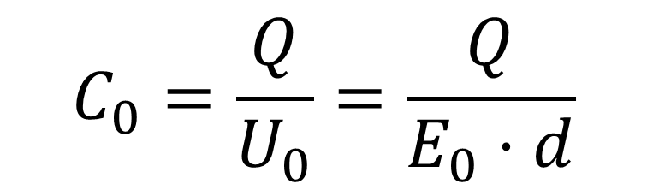
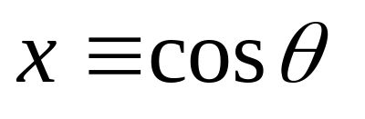
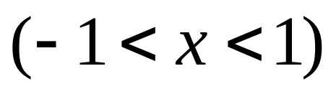
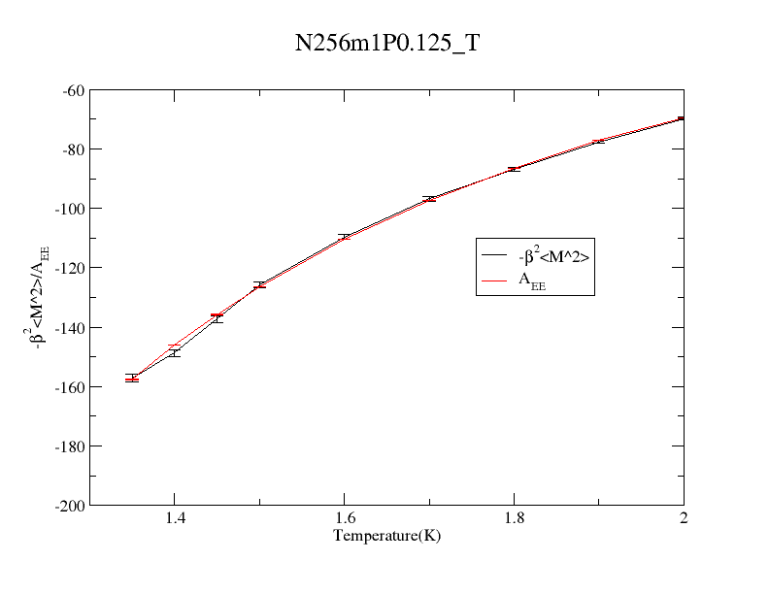
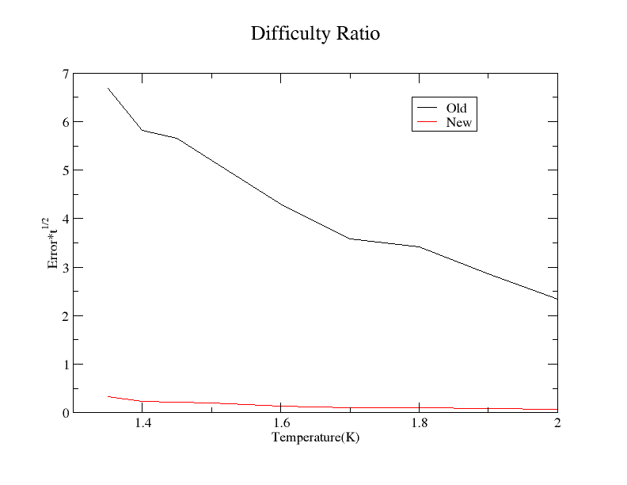
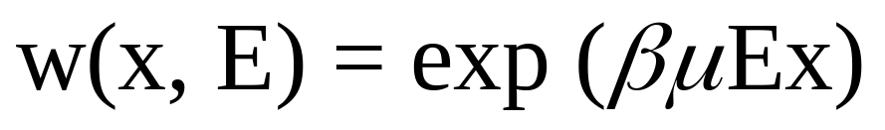

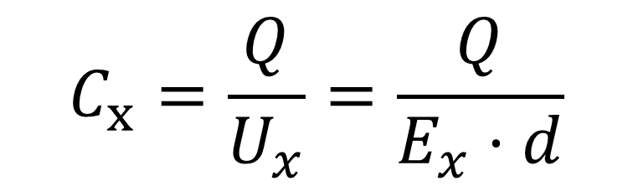
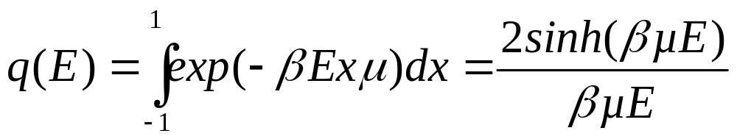
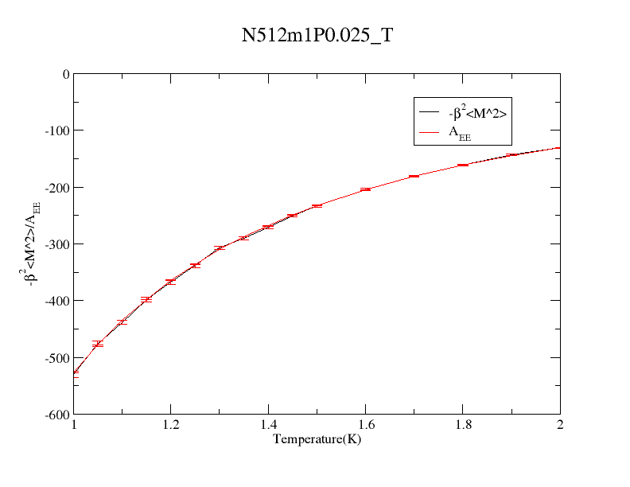
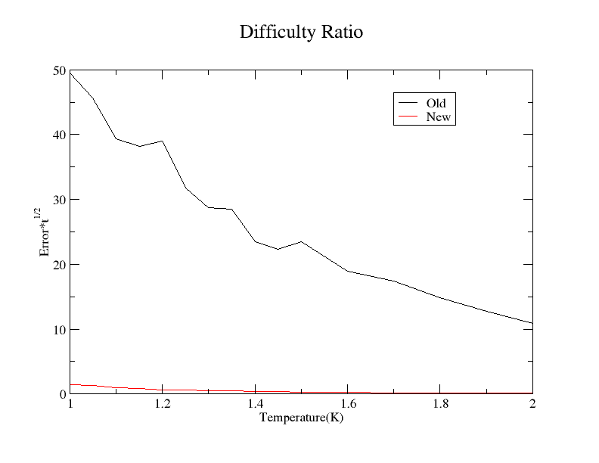
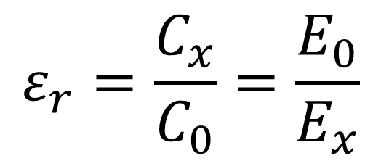
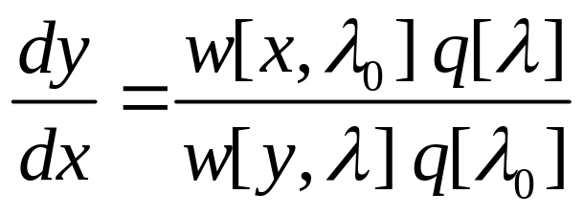

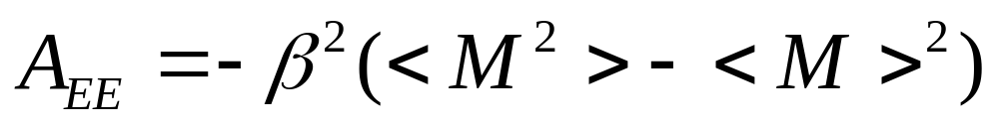
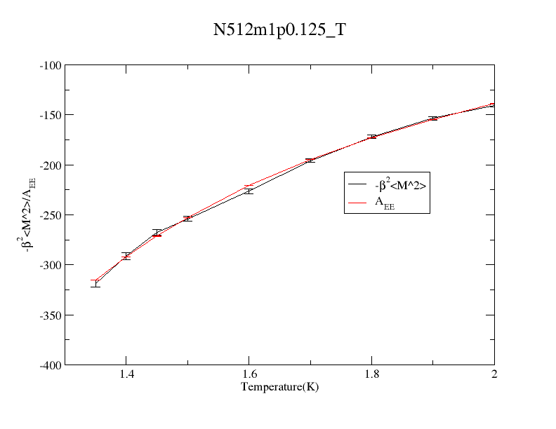
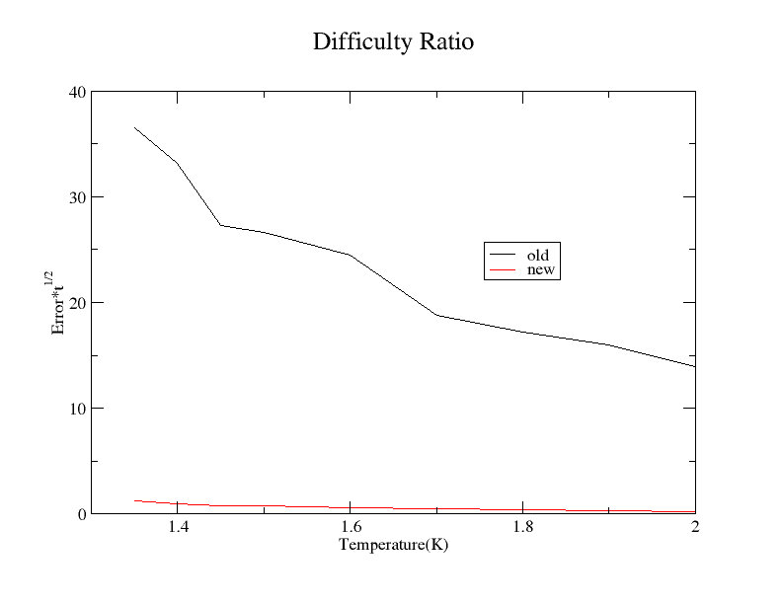
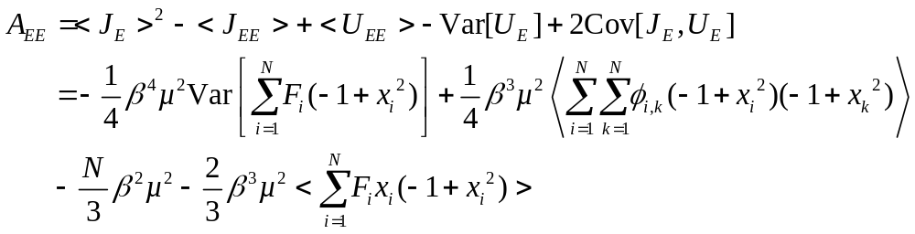

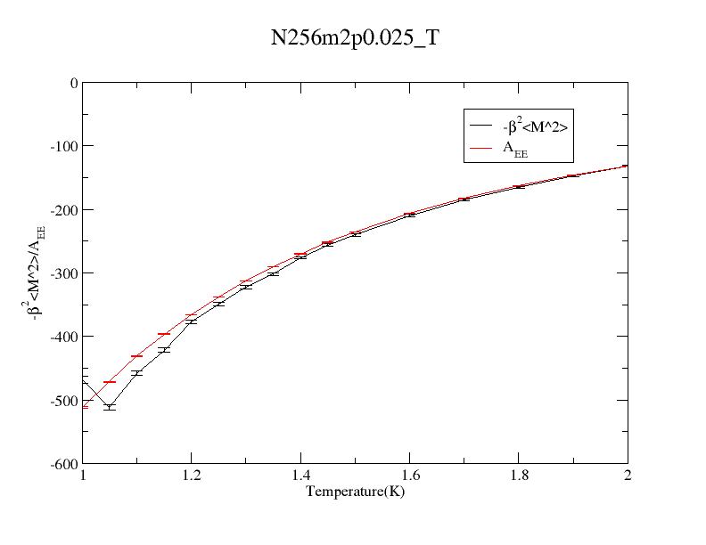
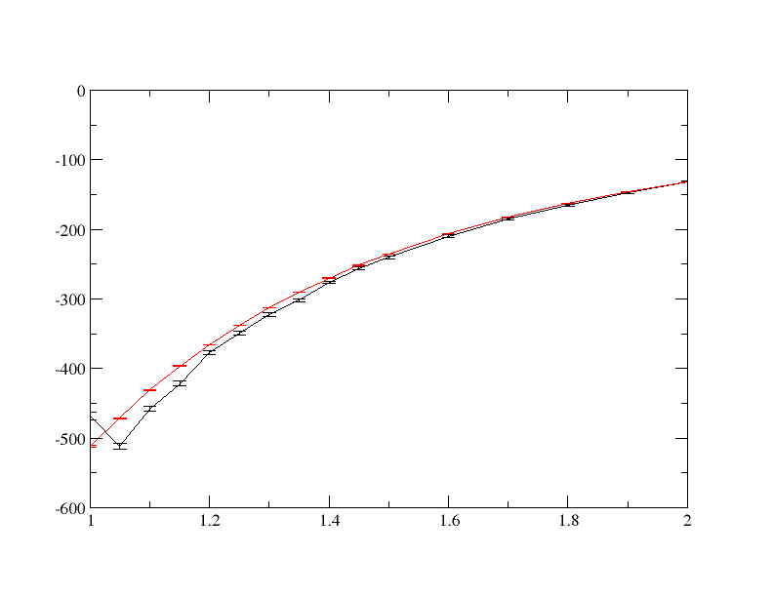

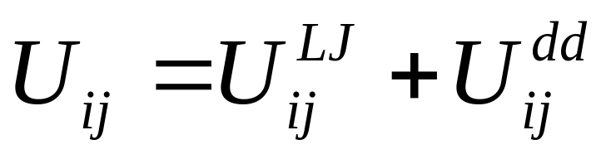

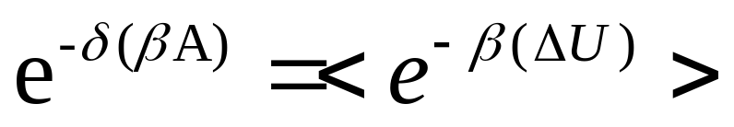
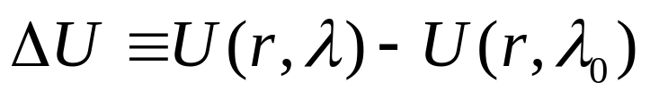
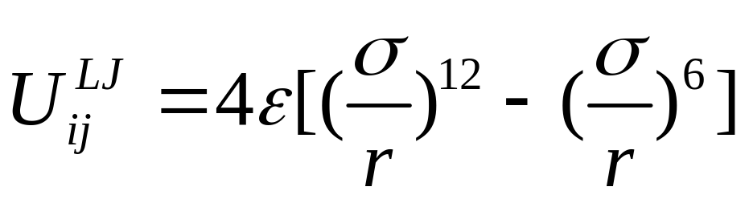
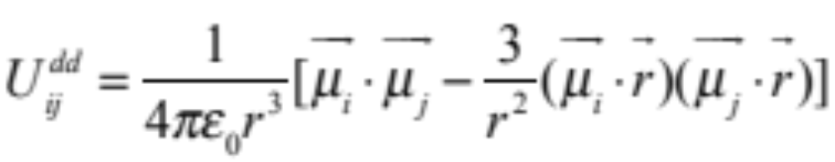
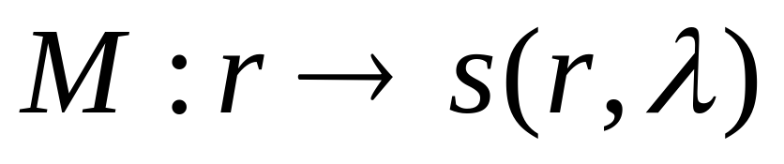
Electric-Field Mapped Averaging for Dielectric Constant
Weisong Lin , Andrew J. Schultz, David A. Kofke
Department of Chemical and Biological Engineering, University at Buffalo, The State University of New York, Buffalo, NY 14260
Introduction
Results
Definition
The dielectric constant (relative permittivity) of a material is the ratio of permittivity or capacitance to that of vacuum.
Dielectric is another name for an insulator (non-conductor). Dielectrics can polarize in the presence of an electric field.
E₀
E
Results for Stockmayer system.
N256m1p0.025 means N=256, dipolestrenthSquare = 2,density = 0.025. etc.
Comparison of CPU times
Dielectric constant is 2nd derivative with respect to an imposed electric field
Coordinate
Boltzmann factor
Partition function
Mapping satisfies
Conventional formulas:
Mapped averaging formulas:
Vacuum
d
θ
Comparison of CPU times
+Q
-Q
E
x = 1 x = -1
Dielectric: Polarization
Electric
filed E
Plate
Area A
Dielectric Constant
Comparison of CPU times
Capacitor with a dielectric inside
Applications
Solvent dielectric constant correlates with solubility of electrolytes and zwitterions (e.g., pharmaceuticals)
Frequency-dependent dielectric constant ε(ω) determines response to oscillating electric field, and thus optical properties such as index of refraction
Design of capacitors, supercapacitors as an energy storage device requires dielectric properties
Dielectric constant characterizes how ionic interactions are attenuated in solution, and thus affects solution properties
Comparison of CPU times
N256m2p0.125_T
Method
Models
Mapped average
Mapped average improves the free-energy perturbation (FEP) by coupling to displacement of coordinates.
Standard FEP:
Introduce mapping to improve precision:
Stockmayer system.
Dipole Lennard-Jones fluid
Lennard-Jones potential
Dipole-dipole potential
References
1. Tan Tai Boon, A. J. Schultz, and D. A. Kofke, 'Efficient Calculation of - and -Nitrogen Free Energies and Coexistence Conditions Via Overlap Sampling with Targeted Perturbation', Journal of Chemical Physics, 135 (2011), 044125 (13 pp.).
2. T. B. Tan, A. J. Schultz, and D. A. Kofke, 'Efficient Calculation of Temperature Dependence of Solid-Phase Free Energies by Overlap Sampling Coupled with Harmonically Targeted Perturbation', Journal of Chemical Physics, 133 (2010).
3. Andrew J. Schultz, Sabry G. Moustafa, and David A. Kofke ‘Direct Calculation of Anharmonic Contributions to Thermodynamic Properties of Crystals by Molecular Simulation’ PACS numbers: 05.10.-a, 65.40.-b

